Slide 1
The Power of Repetition:
An Online Experiment in China
Jie Bai (Harvard)
Donghee Jo (Northeastern)
Nancy Qian (Northwestern)
Excellent research assistance from:
Eliza Huang and Zixin Wei
Prepared for:
C Lab Workshop (May 2019)

Slide 2
“DIVERSE” MEDIA ENVIRONMENT IN NONDEMOCRATIC REGIMES
INTRO
CONTEXT
DESIGN
DISCUSSION
Seemingly vibrant media environment in China (BBC 2018)
2600+ radio stations, 1900+ newspapers, 3300+ TV channels
Almost all news sources are state-owned, for example:
Reference News: Xinhua News Agency (state-run)
People’s Daily: Chinese Communist Party
Guangzhou Daily: Guangzhou Communist Party
Southern Daily: Guangdong Communist Party
Contents: highly controlled
Ranked 176 out of 180 countries (World Press Freedom Index 2018)
Similar in other nondemocratic regimes (Russia, Vietnam)
Focus on one of the reasons: persuasion through repetition
other reasons

Slide 3

POWER OF REPETITION
INTRO
CONTEXT
DESIGN
DISCUSSION
“If you repeat a lie often enough, it becomes the truth.” – Joseph Goebbels (1887-1945)

Slide 4
MORE THAN GOEBBELS
INTRO
CONTEXT
DESIGN
DISCUSSION
“As a user, you might think the information you see is coming from lots of different sources, but in fact it can be part of an orchestrated campaign.” (An author's Interview on Lumezanu et al. 2012)

Slide 5

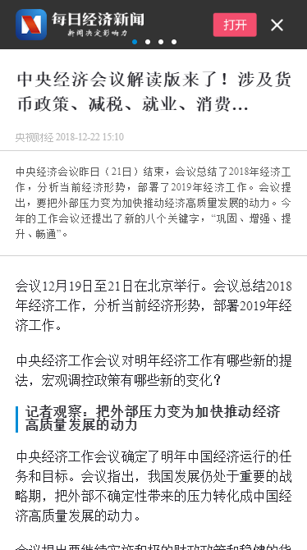
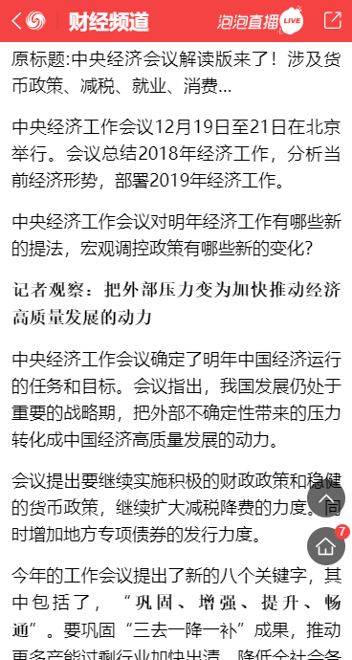
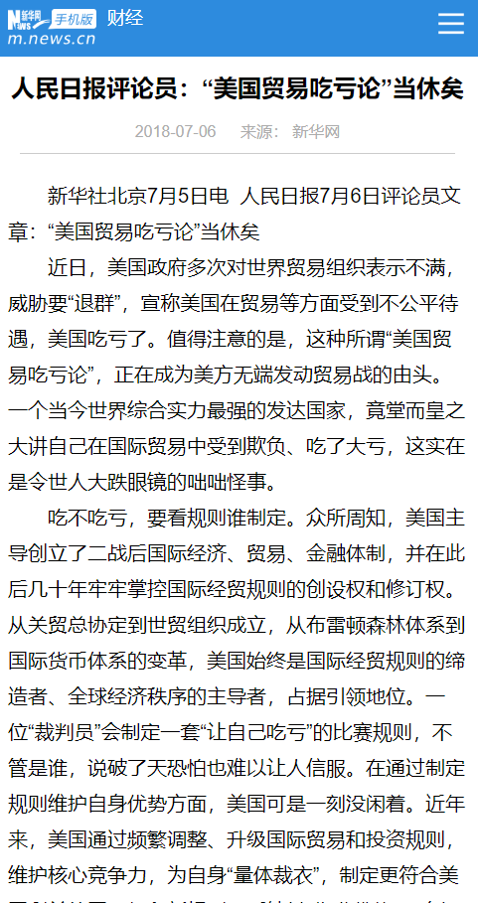
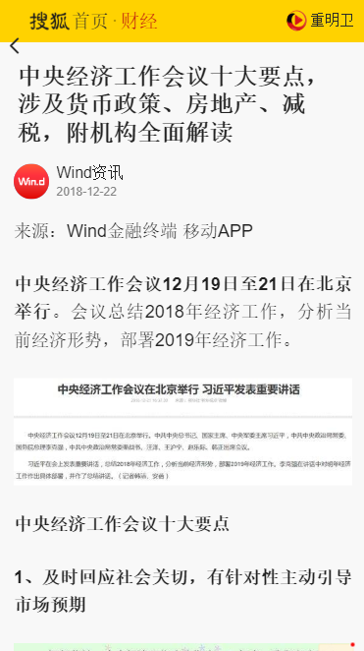
FREQUENTLY USED STRATEGY IN CHINA
INTRO
CONTEXT
DESIGN
DISCUSSION

Slide 6
RESEARCH QUESTIONS
INTRO
CONTEXT
DESIGN
DISCUSSION
In a real-world context of nondemocratic regimes, is repetition by multiple sources effective in persuading people?
Which design aspects of repetitive message are effective in persuading people? If so, why?
Mere repetition?
Repetition by seemingly different news sources?
Repetition over longer (shorter) period of time?
Repetition with(out) attention crowd-out?
Are there ways to counter such persuasion?
Our approach: online experiment with a mobile web app in China
Measure: both belief and actual behavior

Slide 7
LITERATURE REVIEW
INTRO
CONTEXT
DESIGN
DISCUSSION
Mass media in nondemocratic regimes
Enikolopov et al (2011) Chen & Yang (Forthcoming) Qin et al. (2017, 2018)
Correlation neglect and persuasion
Theory: DeMarzo et al (2003) Levy et al (2017)
Empirics: Eyster & Weizsacker (2011) Enke & Zimmerman (2018)
In Psychology
Repetition of visual stimuli: Zajonc (1968) Cox & Cox (2000)
Repetition of message: Cacioppo & Petty (1979, 1989) Koch & Zerback (2013)
Double-counting in financial setting: Unkelbach et al (2007)

Slide 8
INTRO
CONTEXT
DESIGN
DISCUSSION

Slide 9
CONTEXT: AIR QUALITY IN SHANGHAI
INTRO
CONTEXT
DESIGN
DISCUSSION
PM 2.5

Slide 10

CHINESE AIR QUALITY CATEGORIES
INTRO
CONTEXT
DESIGN
DISCUSSION
“Heavily polluted”
“Moderately polluted”
“Lightly polluted”
“Good”
“Excellent”

Slide 11

DIFFERENT FROM US CATEGORIES
INTRO
CONTEXT
DESIGN
DISCUSSION
“Heavily polluted”
“Very unhealthy”
“Moderately polluted”
“Unhealthy”
“Lightly polluted”
“Good”
“Unhealthy for sensitive group”
“Moderate”
“Excellent”
“Good”

Slide 12
OFTEN RADICALLY DIFF. HEALTH IMPLICATIONS
INTRO
CONTEXT
DESIGN
DISCUSSION
“Air quality is acceptable, but some pollutants can be unhealthy for a very small number of abnormally sensitive people”
“Everyone may begin to experience health effects; members of sensitive groups may experience more serious health effects.”
“Good”
“Unhealthy”

Slide 13
INTRO
CONTEXT
DESIGN
DISCUSSION

Slide 14
OUTDOOR EVENT WEB APP
INTRO
CONTEXT
DESIGN
DISCUSSION
Each day, app introduces outdoor event(s) in Shanghai
All events happening in a particular week (approx. four weeks later)
Why? To bundle the air quality information with event info
Provide historical air quality information for the week of events

Slide 15
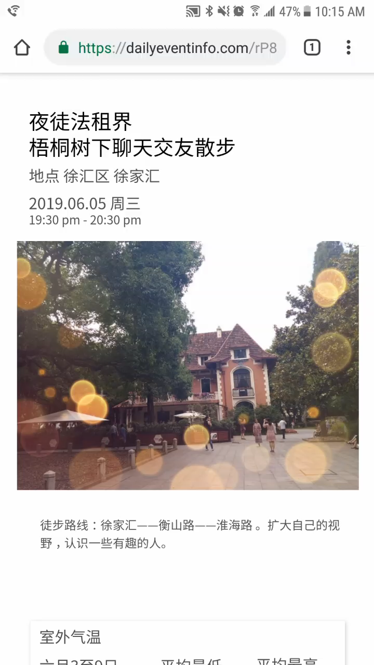


Slide 16
TIMELINE
INTRO
CONTEXT
DESIGN
DISCUSSION
Subjects: university students in Shanghai
Day 1-6: Events info + survey every day
2-week follow-up: longer term effect of information treatment
4-week follow-up: post-events
2-week follow-up
4-week follow-up
Day 1
Day 2
Day 3
Day 4
Day 5
Day 6
≈
≈
Grace Period
Experimental Period

Slide 17
TREATMENT GROUPS AND RESEARCH QUESTIONS
INTRO
CONTEXT
DESIGN
DISCUSSION
All participants
(T1) No repetition (source: randomized)
(T2) Repetition
(T2.S) Single source (SEMC: direct source)
(T2.M) Multiple sources (SEMC + 2 Indirect)
(T2.M.S) One day
(T2.M.M) Multiple days
(T2.M.M.N) No crowd-out
(T2.M.M.C) Crowd-out
(T2.M.M.C.N) No Reminder
(T2.M.M.C.R) Reminder

Slide 18

TREATMENT GROUPS AND RESEARCH QUESTIONS
INTRO
CONTEXT
DESIGN
DISCUSSION
All participants
(T1) No repetition (source: randomized)
(T2) Repetition
(T2.S) Single source (SEMC: direct source)
(T2.M) Multiple sources (SEMC + 2 Indirect)
(T2.M.S) One day
(T2.M.M) Multiple days
(T2.M.M.N) No crowd-out
(T2.M.M.C) Crowd-out
(T2.M.M.C.N) No Reminder
(T2.M.M.C.R) Reminder

Slide 19
TREATMENT GROUPS AND RESEARCH QUESTIONS
INTRO
CONTEXT
DESIGN
DISCUSSION
All participants
(T1) No repetition (source: randomized)
(T2) Repetition
(T2.S) Single source (SEMC: direct source)
(T2.M) Multiple sources (SEMC + 2 Indirect)
(T2.M.S) One day
(T2.M.M) Multiple days
(T2.M.M.N) No crowd-out
(T2.M.M.C) Crowd-out
(T2.M.M.C.N) No Reminder
(T2.M.M.C.R) Reminder

Slide 20
TREATMENT GROUPS AND RESEARCH QUESTIONS
INTRO
CONTEXT
DESIGN
DISCUSSION
All participants
(T1) No repetition (source: randomized)
(T2) Repetition
(T2.S) Single source (SEMC: direct source)
(T2.M) Multiple sources (SEMC + 2 Indirect)
(T2.M.S) One day
(T2.M.M) Multiple days
(T2.M.M.N) No crowd-out
(T2.M.M.C) Crowd-out
(T2.M.M.C.N) No Reminder
(T2.M.M.C.R) Reminder
Is repetition by multiple sources effective in persuading people? T1 vs T2.M

Slide 21
TREATMENT GROUPS AND RESEARCH QUESTIONS
INTRO
CONTEXT
DESIGN
DISCUSSION
All participants
(T1) No repetition (source: randomized)
(T2) Repetition
(T2.S) Single source (SEMC: direct source)
(T2.M) Multiple sources (SEMC + 2 Indirect)
(T2.M.S) One day
(T2.M.M) Multiple days
(T2.M.M.N) No crowd-out
(T2.M.M.C) Crowd-out
(T2.M.M.C.N) No Reminder
(T2.M.M.C.R) Reminder
Which design aspects of repetitive message are effective?
Mere repetition? T1 vs. T2.S

Slide 22
TREATMENT GROUPS AND RESEARCH QUESTIONS
INTRO
CONTEXT
DESIGN
DISCUSSION
All participants
(T1) No repetition (source: randomized)
(T2) Repetition
(T2.S) Single source (SEMC: direct source)
(T2.M) Multiple sources (SEMC + 2 Indirect)
(T2.M.S) One day
(T2.M.M) Multiple days
(T2.M.M.N) No crowd-out
(T2.M.M.C) Crowd-out
(T2.M.M.C.N) No Reminder
(T2.M.M.C.R) Reminder
Which design aspects of repetitive message are effective?
Repetition by seemingly difference news sources? T2.S vs. T2.M

Slide 23
TREATMENT GROUPS AND RESEARCH QUESTIONS
INTRO
CONTEXT
DESIGN
DISCUSSION
All participants
(T1) No repetition (source: randomized)
(T2) Repetition
(T2.S) Single source (SEMC: direct source)
(T2.M) Multiple sources (SEMC + 2 Indirect)
(T2.M.S) One day
(T2.M.M) Multiple days
(T2.M.M.N) No crowd-out
(T2.M.M.C) Crowd-out
(T2.M.M.C.N) No Reminder
(T2.M.M.C.R) Reminder
Day 4
Day 5
Day 6
Which design aspects of repetitive message are effective?
Repetition over longer (shorter) period of time? T2.M.S vs. T2.M.M
longer period → harder to remember the air quality info (less persuasion)
longer period → harder to remember the source of info (more persuasion)

Slide 24

TREATMENT GROUPS AND RESEARCH QUESTIONS
INTRO
CONTEXT
DESIGN
DISCUSSION
All participants
(T1) No repetition (source: randomized)
(T2) Repetition
(T2.S) Single source (SEMC: direct source)
(T2.M) Multiple sources (SEMC + 2 Indirect)
(T2.M.S) One day
(T2.M.M) Multiple days
(T2.M.M.N) No crowd-out
(T2.M.M.C) Crowd-out
(T2.M.M.C.N) No Reminder
(T2.M.M.C.R) Reminder

Slide 25
TREATMENT GROUPS AND RESEARCH QUESTIONS
INTRO
CONTEXT
DESIGN
DISCUSSION
All participants
(T1) No repetition (source: randomized)
(T2) Repetition
(T2.S) Single source (SEMC: direct source)
(T2.M) Multiple sources (SEMC + 2 Indirect)
(T2.M.S) One day
(T2.M.M) Multiple days
(T2.M.M.N) No crowd-out
(T2.M.M.C) Crowd-out
(T2.M.M.C.N) No Reminder
(T2.M.M.C.R) Reminder
Which design aspects of repetitive message are effective?
Repetition with(out) attention crowd-out? T2.M.M.N vs. T2.M.M.C
w/ crowd-out → less exposure to the air quality info (less persuasion)
w/ crowd-out → less exposure to the source of info (more persuasion)

Slide 26
TREATMENT GROUPS AND RESEARCH QUESTIONS
INTRO
CONTEXT
DESIGN
DISCUSSION
All participants
(T1) No repetition (source: randomized)
(T2) Repetition
(T2.S) Single source (SEMC: direct source)
(T2.M) Multiple sources (SEMC + 2 Indirect)
(T2.M.S) One day
(T2.M.M) Multiple days
(T2.M.M.N) No crowd-out
(T2.M.M.C) Crowd-out
(T2.M.M.C.N) No Reminder
(T2.M.M.C.R) Reminder
Are there ways to counter such persuasion?

Slide 27
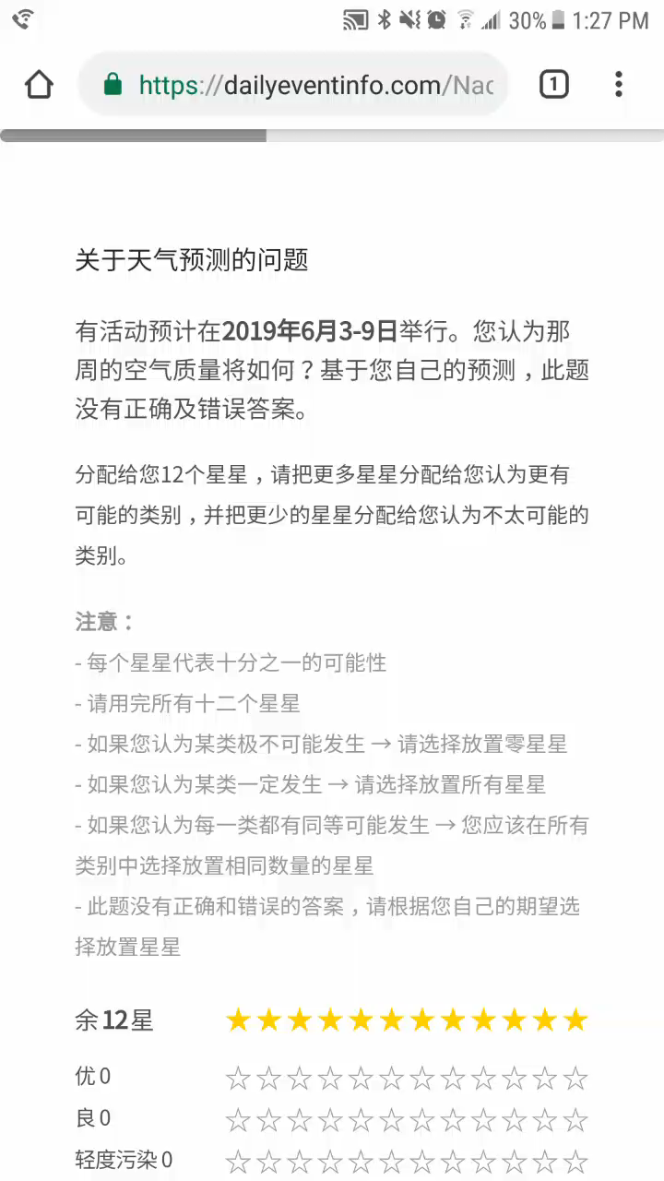
KEY OUTCOME VARIABLE: BELIEF
INTRO
CONTEXT
DESIGN
DISCUSSION
“Probabilistic expectations”
Manski (2004), Shrestha (2016), Dizon-Ross (forthcoming)
Elicit mean and variance of individual beliefs
Prior + posterior + longer-run posterior
Testers (N=20): roughly normal-like distribution

Slide 28
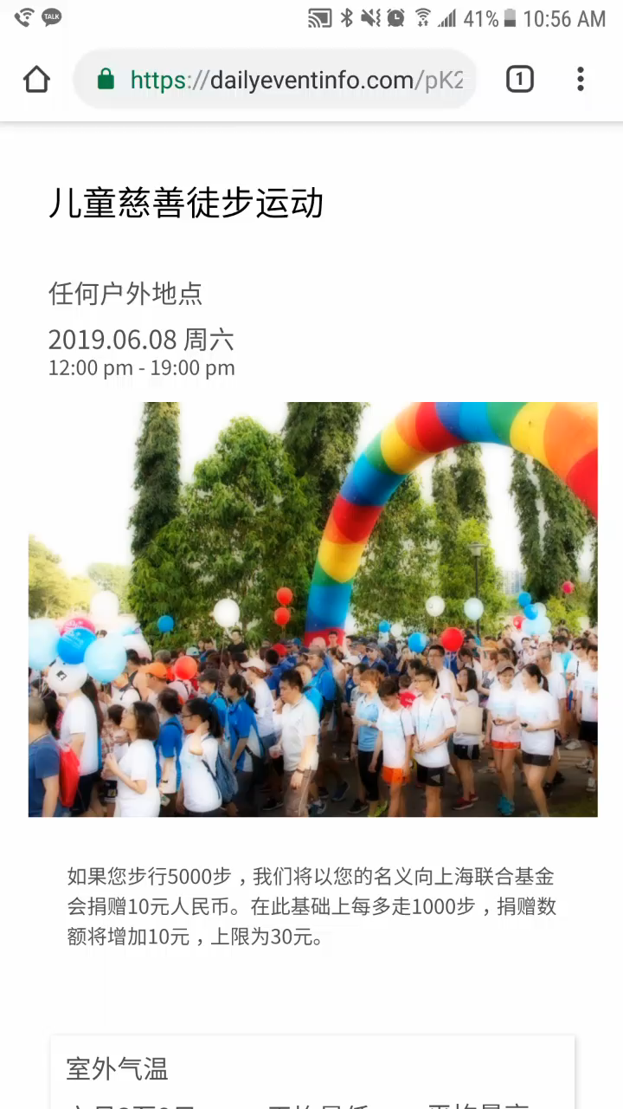
KEY OUTCOME VARIABLE: BEHAVIOR
INTRO
CONTEXT
DESIGN
DISCUSSION
Day 6: our own event

Slide 29
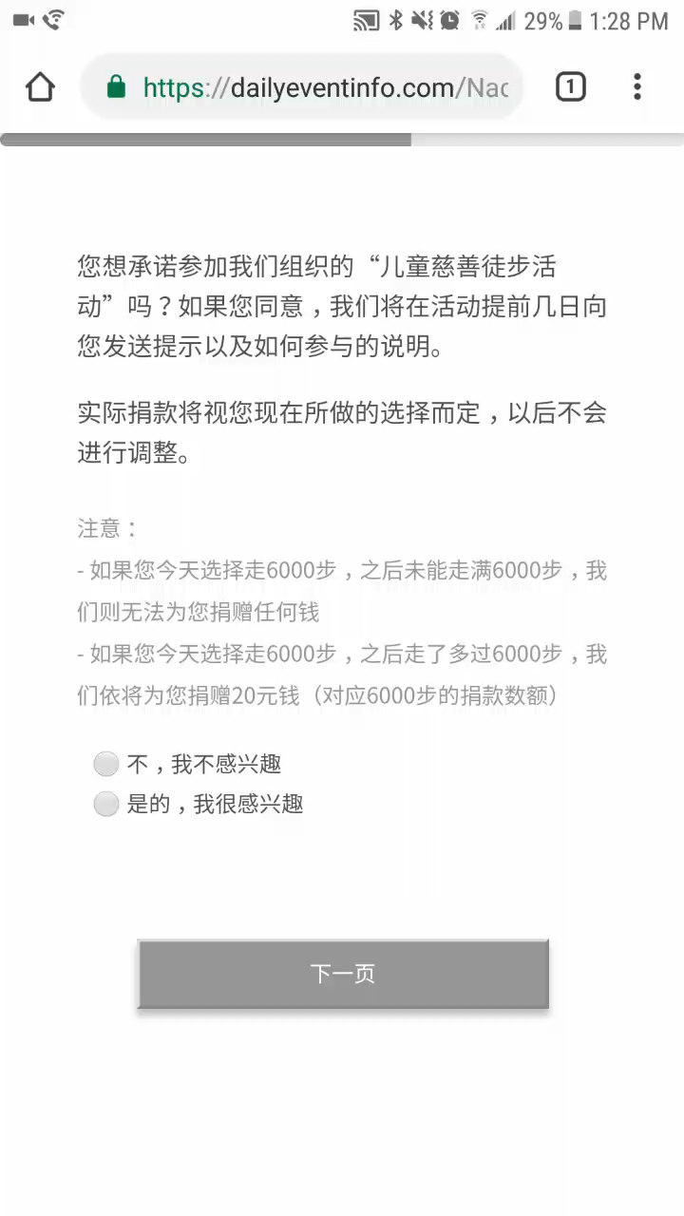
KEY OUTCOME VARIABLE: BEHAVIOR
INTRO
CONTEXT
DESIGN
DISCUSSION
Day 6: our own event
Would you like to walk outside to donate money to a local NGO? How many steps?
Initial pledge: Day 6
Revised pledge: 2 weeks later (persistence)
Actual steps taken: 4 weeks later
Testers (N=19)
14 said interested after Day 6
Mean 6300 steps (5.0 km; 3.1 mile; $3.4 donation)

Slide 30
INTRO
CONTEXT
DESIGN
DISCUSSION

Slide 31
PSYCHOLOGICAL UNDERPINNINGS
INTRO
CONTEXT
DESIGN
DISCUSSION
Plan to provide suggestive answers via survey
Rational: (i) people take into account the fact that the media could've omit the info (ii) multidimensional updating (not only air pollution level, but also bias and journalistic competence)
Ignorance: people may not know that the info is coming from the same ultimate source.
Limited attention: people do not pay enough attention to the (ultimate or immediate) source of information.
Limited memory: people do not (or not perfectly) remember the source of info (source-tagging) for future belief updating purposed.
Limited cognitive ability: people are cognitively limited to think through the correlation between signals, even when they have all the information necessary for such task.
Generalizability: heterogeneous treatment effect w.r.t behavioral regularities documented in abstract settings (e.g., Enke and Zimmerman 2018)

Slide 32
CONCLUSION
INTRO
CONTEXT
DESIGN
DISCUSSION
Seemingly vibrant media environment in nondemocratic regimes: could be effective in persuasion
Experimentally study which design aspects of repetition are most effective in a real-world setting under nondemocratic regime
Learning which design aspects are effective → useful to design a more realistic campaign to counter repetition
Seemingly different sources: educating news consumer about the highly correlated signal structure
Timeframe and crowd-out: selecting issues/population to focus on
Any feedback will be very much appreciated. Thank you!

Slide 33
INTRO
CONTEXT
DESIGN
DISCUSSION

Slide 34
SOME POTENTIAL REASONS FOR ALLOWING MULTIPLE NEWS OUTLETS
INTRO
CONTEXT
DESIGN
DISCUSSION
Increased coverage for horizontal tastes (esp. vis-à-vis advertising industry)
Factions within party (Newson and Trebbi 2018)
Quality control for local Bureaucrats (Qin et al. 2014)
Persuasion (propaganda, brainwashing): OUR FOCUS
Back

